Slide 1
Crash Course on Classical Theory of Computation
Eric Bond Fall 2017

Slide 2
Outline
Introduction to Logic.
Brief History of Logic
Logic’s Influence on the Construction of the Machine.
Formal Language Theory & Automata Theory
Lambda Calculus
Intuitionistic Logic & Natural Deduction
Curry Howard Isomorphism.
Bleeding Edge: Homotopy Type Theory.

Slide 3
Computation
Definition: A computer is an artifact that performs computation.
But what is computation?

Slide 4
Logic
A Language?
Syntax
Semantics

Slide 5
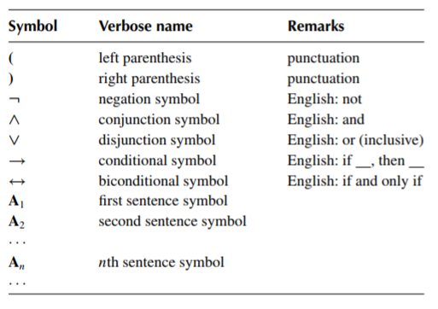
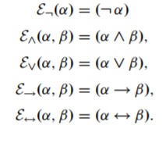
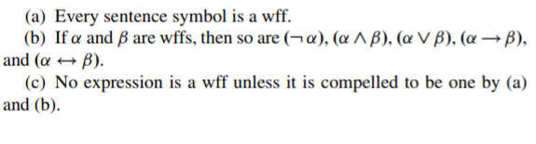
Syntax of Propositional Logic

Slide 6
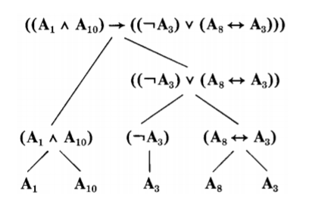
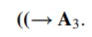
Examples

Slide 7
Induction Principle
For well formed formulas
If S is a set of well formed formulas containing all the sentence symbols and closed under all five formula-building operations, then S is the set of all wffs.
In general
Assume that C is the set generated from B by the functions in F.
If S is a subset of C that includes B and is closed under the functions of F, then S = C.
“Inductive Structures”
Groups generated by an element
Span of a basis set
Data structures (binary tree, lists, abstract data types…)
Programming language syntax

Slide 8
Extension of Syntax (First Order Logic)
Logical Symbols
Parenthesis
Sentential connective symbols: ->, V, &, <->
Variables: v1, v2, v3, … vn
Equality symbol (optional): =
Parameters
Quantifier symbols: ꓯ, ꓱ
Predicate symbols: ex) P(v1, v2) or P(v1,v2,v3)
Constant symbols:
Function symbols: ex) f(v1)

Slide 9
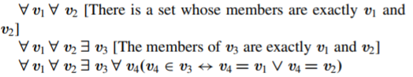
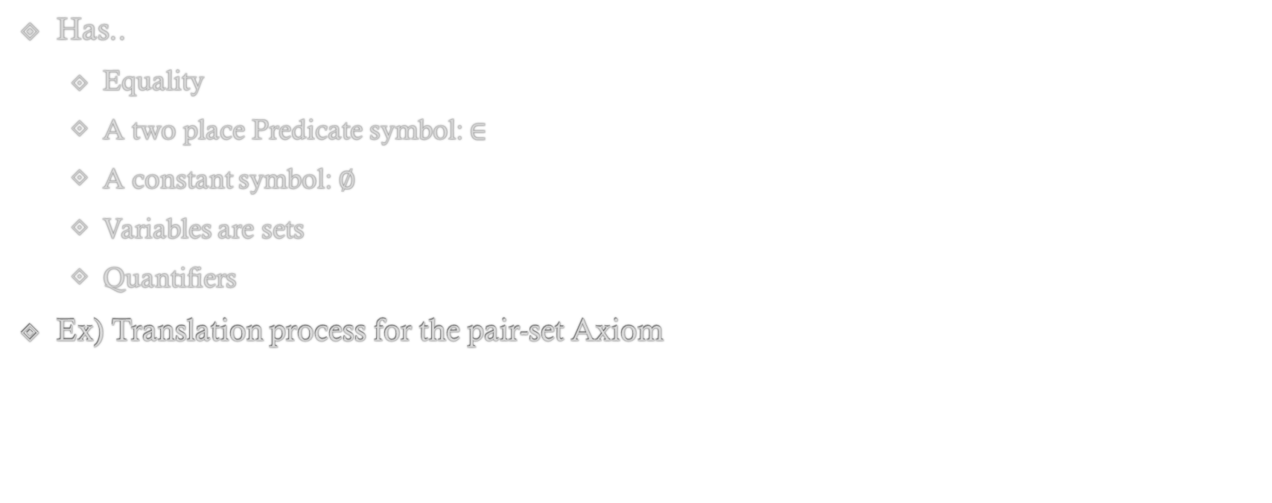
A FOL Syntax for Set Theory
Has..
Equality
A two place Predicate symbol: $∈$
A constant symbol: $∅$
Variables are sets
Quantifiers
Ex) Translation process for the pair-set Axiom

Slide 10
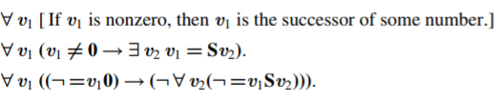
A FOL Syntax for Elementary Number Theory
Has
Equality
1 two-place predicate symbol: <
Constant symbol: 0
1 One-place function symbol: S (successor)
3 Two-place function symbols:
+ (addition)
* (multiplication)
E (exponent)

Slide 11
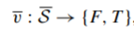
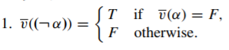
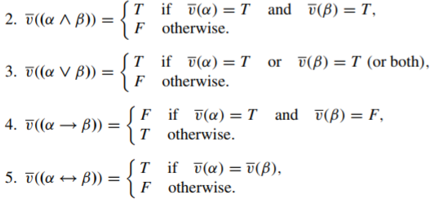
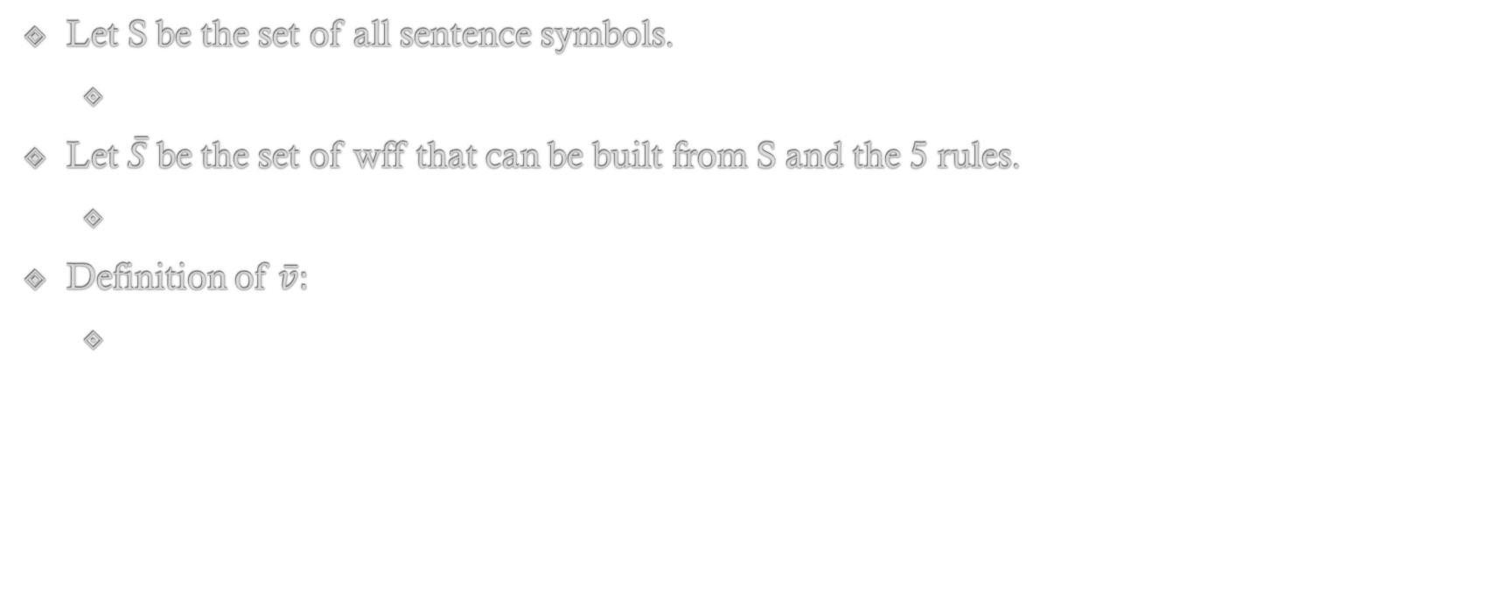
Elementary Semantics (2-value Logic)
Let S be the set of all sentence symbols.
Let $\overline{S}$ be the set of wff that can be built from S and the 5 rules.
Definition of $\overline{v}:$

Slide 12
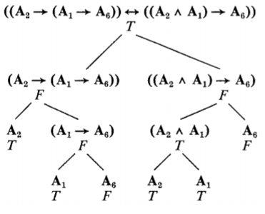
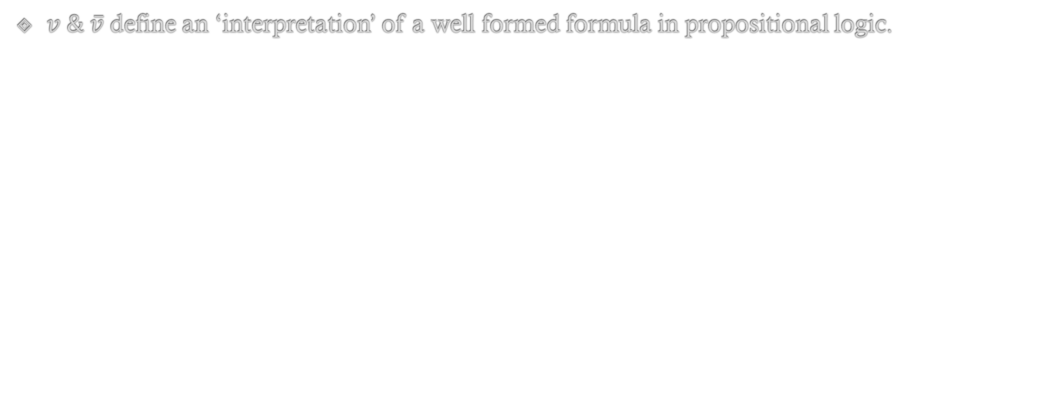
Example
$v \& \overline{v}$define an ‘interpretation’ of a well formed formula in propositional logic.

Slide 13
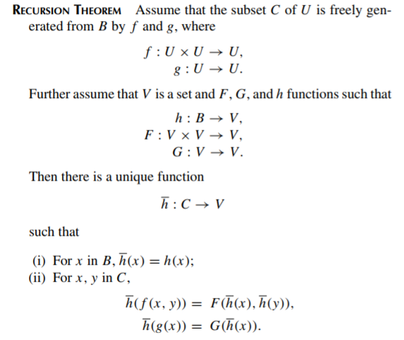
Recursion

Slide 14
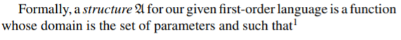
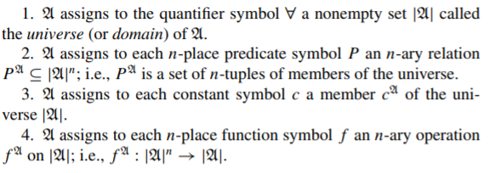
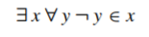
Model Theoretic Semantics

Slide 15
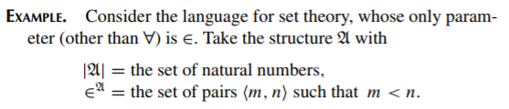
Structure Swapping
And with a different structure….

Slide 16
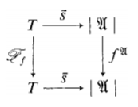
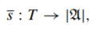
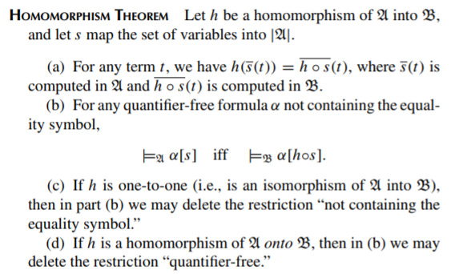
Homomorphic Structures and Alternative Logics
Wff of FOL are Inductively generated as well..
Definable Structures?
Groups
Vector Spaces
Fields
Graphs
Many valued logic
Possibility Theory vs Probability Theory
Set Theory vs Fuzzy Set Theory

Slide 17
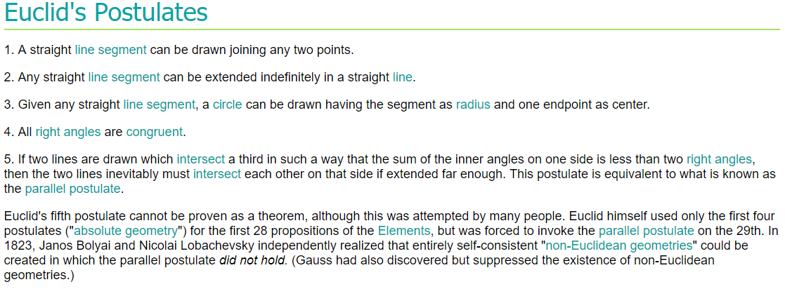
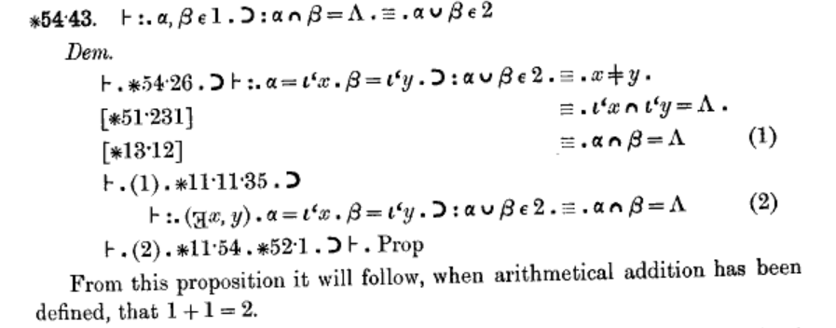
A Brief History of Logic, Rise of Axiomatic Mathematics
Aristotle: Syllogisms, ‘Categories’
Gottfried Leibniz (1700s):
Universal Characteristic
Does a universal and formal language able to express all Mathematical, Scientific, and Metaphysical concepts exist? What would its calculus be?
Gottlob Frege(mid 1800s):
A Formal Language for Pure Thought Modeled on that of Arithmetic
George Boole(mid 1800s):
An Investigation into the Laws of Thought
The goals of Hilbert’s Program(early 1900s)
A formulation of all mathematics; in other words all mathematical statements should be written in a precise formal language, and manipulated according to well defined rules.
Completeness: a proof that all true mathematical statements can be proved in the formalism.
Consistency: a proof that no contradiction can be obtained in the formalism of mathematics. This consistency proof should preferably use only "finitistic" reasoning about finite mathematical objects.
Conservation: a proof that any result about "real objects" obtained using reasoning about "ideal objects" (such as uncountable sets) can be proved without using ideal objects.
Decidability: there should be an algorithm for deciding the truth or falsity of any mathematical statement.
Principia Mathematica

Slide 18
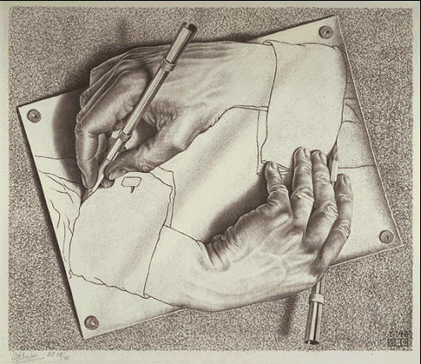
Continued..
Is Mathematics pure formalism?
“No” – Godel’s Incompleteness Theorems (1931)
Any formal system strong enough to express arithmetic will be ‘incomplete’. I.e. there are theorems that are unprovable within your formal system.
“This sentence is false”
Entscheidungsproblem (German for decision problem) - Hilbert (1928)
The problem asks for an algorithm that takes as input a statement of a first-order logic (possibly with a finite number of axioms beyond the usual axioms of first-order logic) and answers "Yes" or "No" according to whether the statement is universally valid, i.e., valid in every structure satisfying the axioms
“No” – Church-Turing Thesis(1936)
Alan Turing via Turing Machine model
Alonzo Church via Lambda Calculus
Yielded 2 equally powerful models of computation.
Firm definition of algorithm and computation.

Slide 19
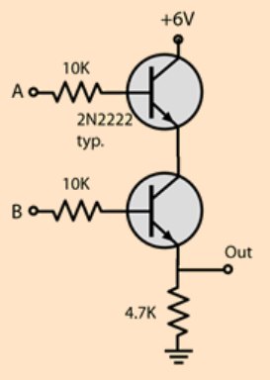
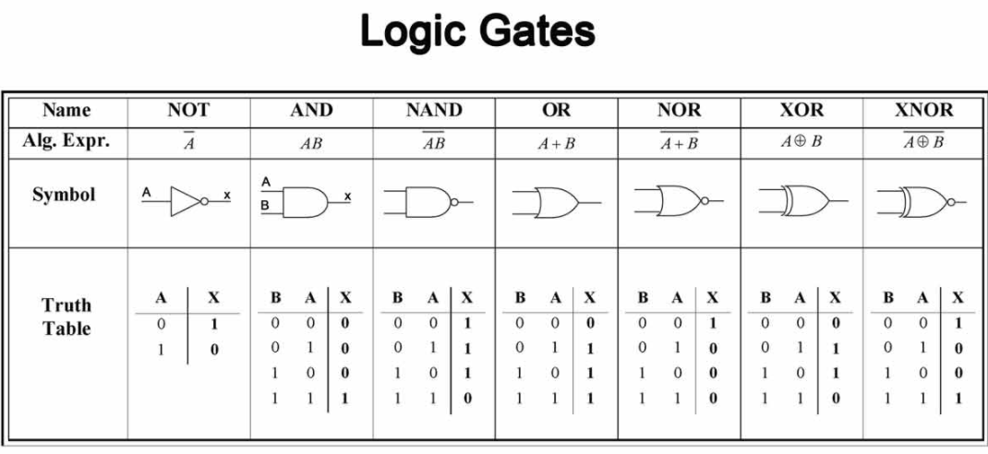
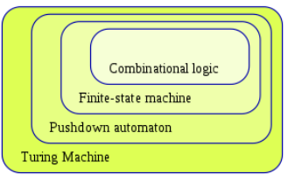
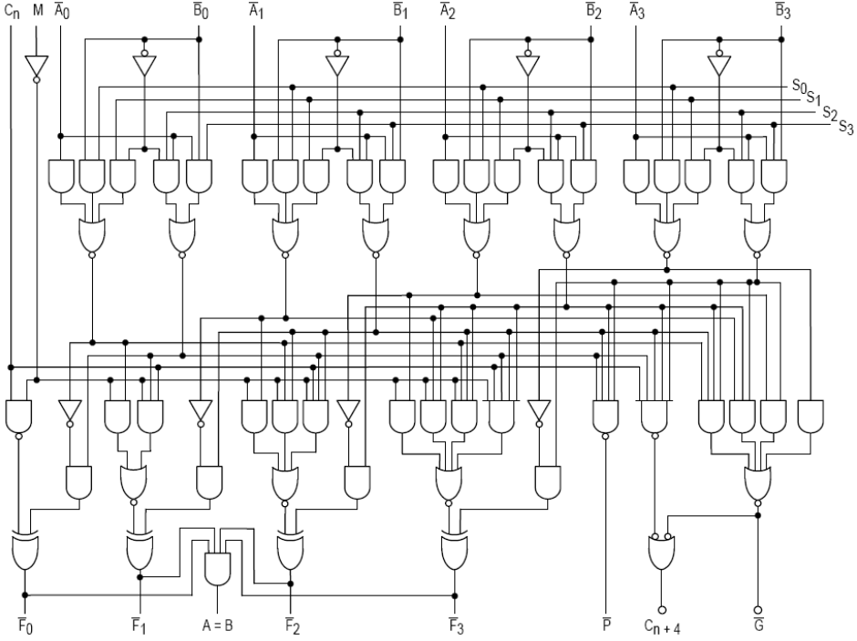
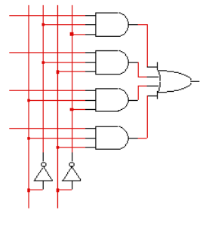
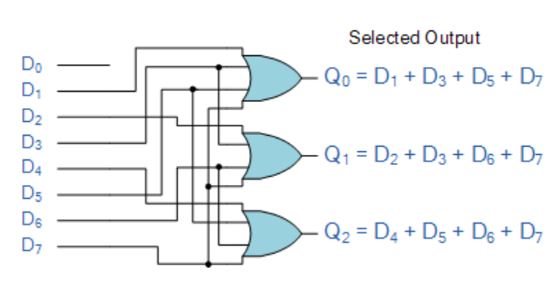
Logic’s Influence on Architecture.

Slide 20
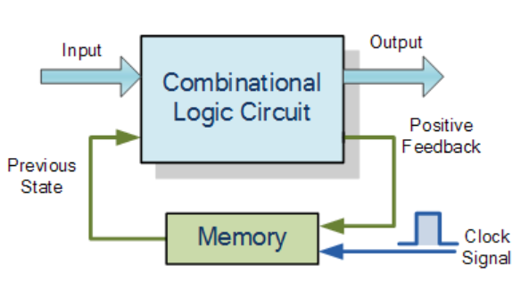
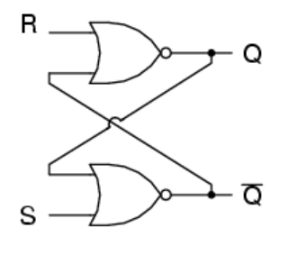
Time Dependent vs Independent Logic
Combinatorial logic circuits are pure Boolean functions.
Independent of time,.
Output only as a function of input
Time dependent circuits use input and previous state.

Slide 21
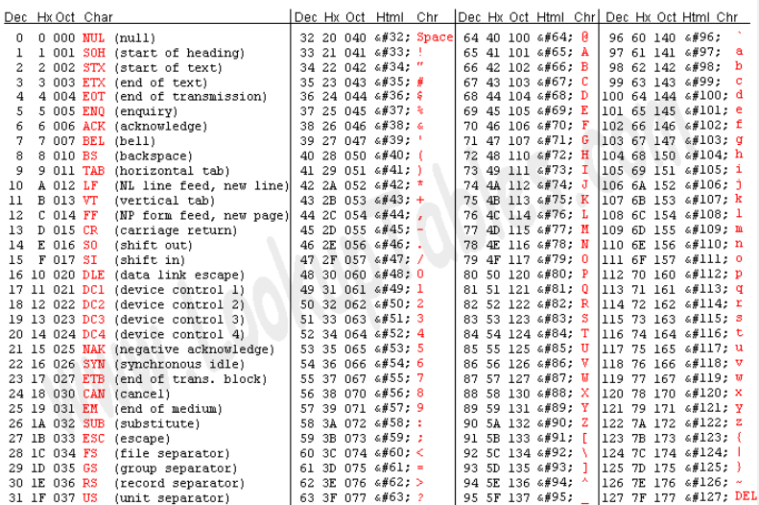
Formal Language Theory
Set of Symbols
Set of Rules
Inductively generate ‘words’ ( valid sequences / wff)
Set of ‘words’ is a ‘language’
Are there languages for music? English? DNA?

Slide 22
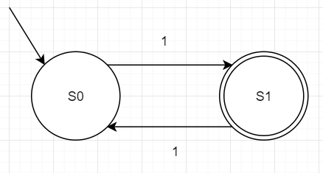
Example
Language: Odd natural numbers in a unary number system.
Symbols = {1}
Rules = { f(x) = x11 }

Slide 23
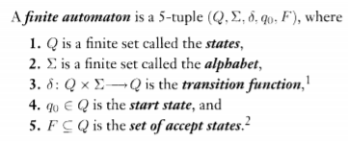
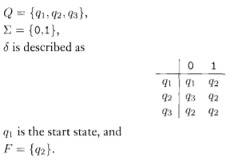
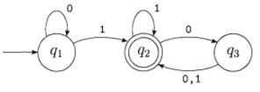
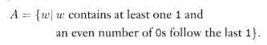
Deterministic Finite Automaton

Slide 24
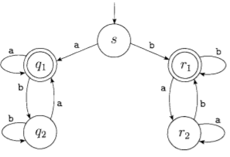
Another Example
What does this one do?

Slide 25
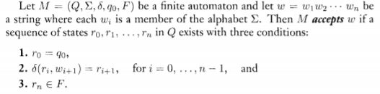
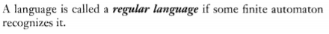
A Definition of Computation

Slide 26
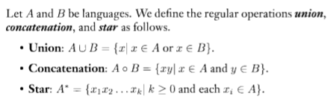
Operations on Regular Languages

Slide 27
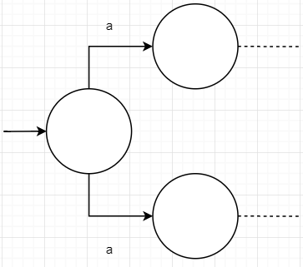
More than one choice

Slide 28
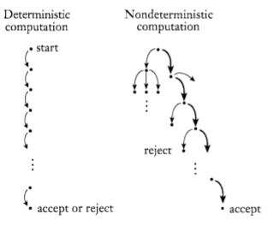
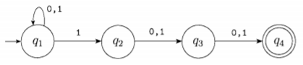
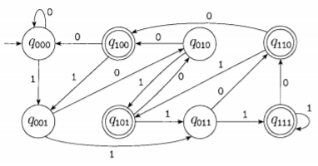
Non-Deterministic Finite Automaton
For the same language
NFA
DFA

Slide 29
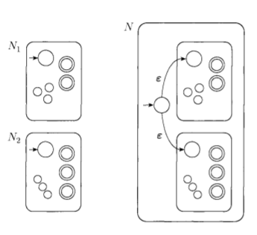
Proof of Closure Under Union

Slide 30
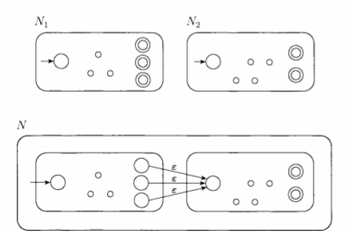
Proof of Closure Under Composition

Slide 31
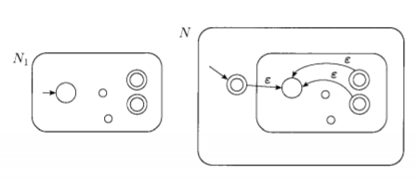
Proof of Closure Under Kleene Star

Slide 32

Different Notation: Regular Expressions

Slide 33

DFA to Regular Expression

Slide 34

A Non-Regular Language

Slide 35


Context Free Grammars

Slide 36


Context Free Grammars: English

Slide 37

Derivation Example

Slide 38

Context Free Grammars: Arithmetic Expressions

Slide 39

Push Down Automaton

Slide 40
Other Machines
The usual
DFA NFA – Regular languages
Pushdown Automata – CFG
Turing Machines – Recursively Enumerable Languages
Alternatives & Variations
Probabilistic FA (Markov Chain with additional structure) – Stochastic Languages
Quantum FA -- ?? Generalization of PFA
Quantum TM
Introduction to the Theory of Computation – Sipser

Slide 41






Lambda Calculus
A calculus to capture the idea of applying arguments to functions.
Computation by substitution.
Syntax
Rules
$\left(λx.Fx\right)↔F$ Eta-conversion x can not be free in F

Slide 42

Encoding Peano Arithmetic via Church Numerals

Slide 43

Encoding Peano Arithmetic via Church Numerals

Slide 44


Other Encodings

Slide 45

Recursion, Reduction, & Types
Recursion
$Ω≡(λx.xx)(λx.xx)$
Y combinator: $Y≡(λy.(λx.y\left(xx\right))(λx.y\left(xx\right))$)
Reduction Order Matters
Consider ($λx.λy.y)[\left(λz.zz\right)\left(λz.zz\right)]$
Reduce argument yields: ($λx.λy.y)[\left(λz.zz\right)\left(λz.zz\right)]$
Substitution yields: $(λy.y)$
Simply Typed Lambda Calculus
$λ^{A→A}x.x$
$x:A$

Slide 46
Logic: Perspective and Alternate Forms
Many viewpoints, 2 prominent
Formalism – Hilbert
Higher mathematics is no more than a formal game. The statements of higher-order mathematics are uninterpreted strings of symbols. Proving such statements is no more than a game in which symbols are manipulated according to fixed rules.
Intuitionistic – Brouwer
Mathematics is essentially an activity of construction. The natural numbers are mental constructions, the real numbers are mental constructions, proofs and theorems are mental constructions, mathematical meaning is a mental construction… Mathematical constructions are produced by the ideal mathematician
Classical vs Intuitionistic Logic
Classical: more axioms, fewer rules
Intuitionistic: less axioms, more rules

Slide 47

Intuitionistic Logic: Formulated in Gentzen-style Natural Deduction

Slide 48

Intuitionistic Logic Rules with Proof Terms

Slide 49

Linear Logic Rules

Slide 50


Recent Developments

Slide 51

Vladimir Voevodsky
The first component is a formal deduction system: a language and rules of manipulating sentences in this language that are purely formal, such that a record of such manipulations can be verified by a computer program.
The second component is a structure that provides a meaning to the sentences of this language in terms of mental objects intuitively comprehensible to humans.
The third component is a structure that enables humans to encode mathematical ideas in terms of the objects directly associated with the language.

Slide 52
Review
Introduction to Logic.
Brief History of Logic
Logic’s Influence on the Construction of the Machine.
Formal Language Theory & Automata Theory
Lambda Calculus
Intuitionistic Logic & Natural Deduction
Curry Howard Isomorphism.
Bleeding Edge: Homotopy Type Theory.

